Slide 1


MY FTS JOURNEY
12/08/14
BlackBerry Confidential

Slide 2
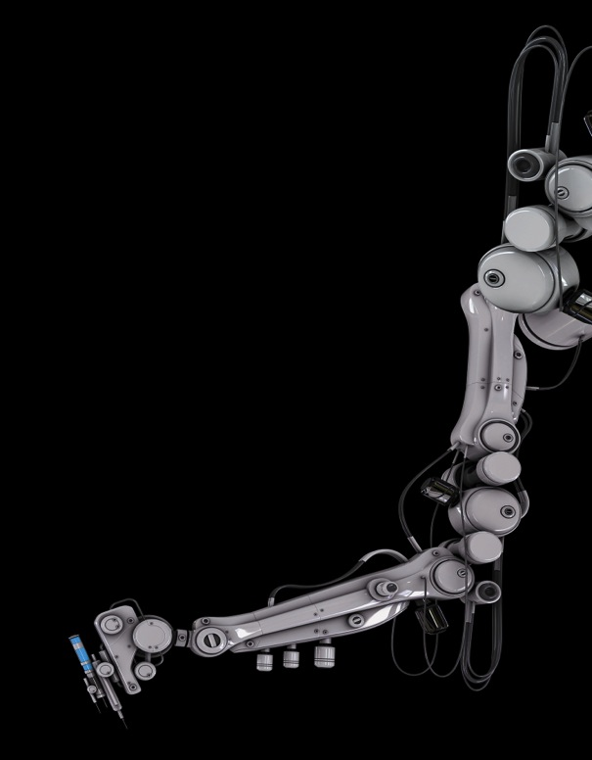
WHAT DID I DO?
Conducted user acceptance, underground and cross platform testing on various mobile handset devices both in NPI and in market.
Developed a Carey Car System to aid testers to organise mobility testing and supplement potential cost reductions.
Issue Investigation on gating issues
Communicating with developers to provide additional information and logs about the issue.
Developed a small script that extracted failed issues during automation and presented them to testers in a clean format.
Notes:
Eloborate on each point and how it will help me later in industry. (Software development)

Slide 3

Skills and Technologies
Python
CSS
HTML
Bootstrap 3
Software Testing
PHP
MYSQL
Version Control Systems
Git/Github
jQuery
JavaScript
Notes:
Here is a list of all the different technologies I have learned and gained experience with while being here.
Creating the carer car system to a high standard and using methods such as making it mobile friendly was a very good challenge.
Using technologies like Version Control systems which was actually introduced to me through Tom and then later reinforced through a presentation with Juan was really good. I can now confidently use it in my assignments and later work; Something which is high in demand in industry.

Slide 4

What I Learned?
Working in a cooperate environment
Applying different skills and technologies learned in university to a professional environment is a big change.
Communicating with team members in office and also from different countries.
Insight and opinions of professionals in industry
Technical Skills
Notes:
List of non specific things I have learned and more skills orientated.

Slide 5
MY TIME AT BLACKBERRY HAS EXCITED ME FOR A BRIGHT FUTURE.

Slide 6
THANK YOU EVERYONE ☺

